Slide 1
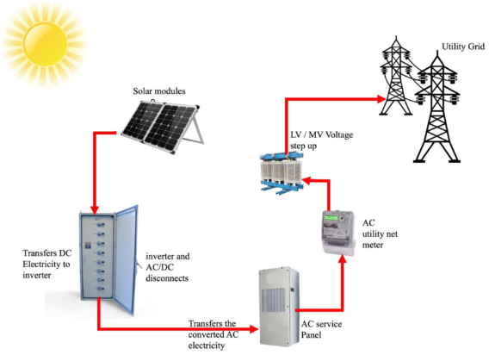
Solar Power Plant Design

Slide 2
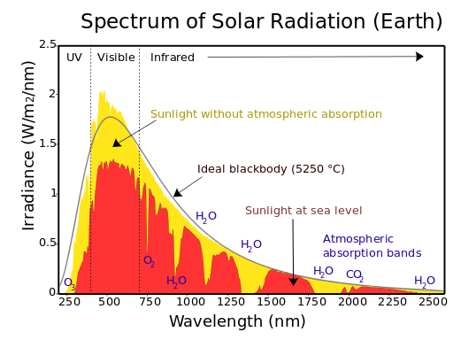
Solar Spectrum

Slide 3
Solar Spectrum
Radiation
Irradiance
Irradiation/ Insolation

Slide 4
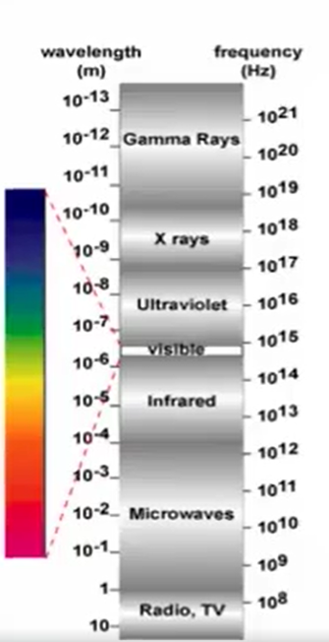
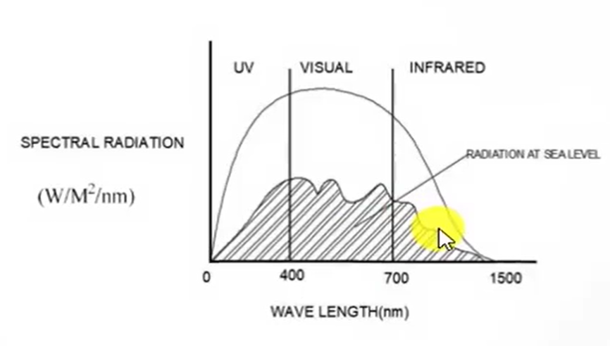
Solar Spectrum

Slide 5
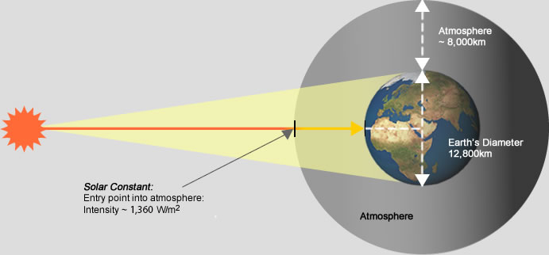
Solar Constant

Slide 6
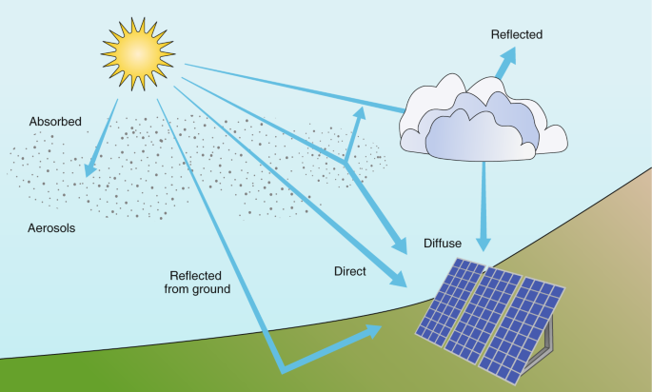
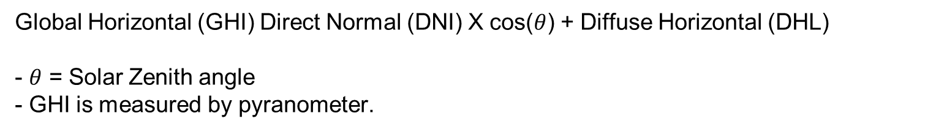
Components of Solar Radiation
1. DNI
2. DHI
• Direct Normal irradiance (DNI)
• Diffuse Horizontal Irradiance (DAI)
• Global Horizontal Irradiance (GHI)
Global Horizontal (GHI) Direct Normal (DNI) X cos($θ$) + Diffuse Horizontal (DHL)
- $θ$ = Solar Zenith angle
- GHI is measured by pyranometer.

Slide 7
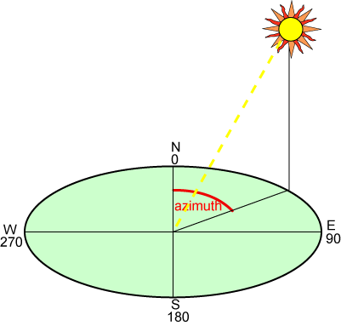
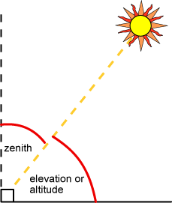
Defining Sun position
1. AZIMUTH
2. ALTITUDE
3. ZENITH

Slide 8
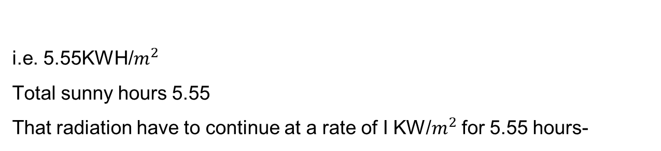
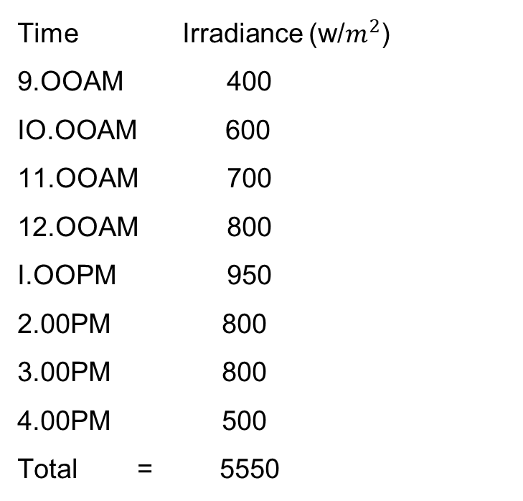
Total sunny hours
Time Irradiance (w/$m^{2}$)
9.OOAM 400
IO.OOAM 600
11.OOAM 700
12.OOAM 800
I.OOPM 950
2.00PM 800
3.00PM 800
4.00PM 500
Total = 5550
i.e. 5.55KWH/$m^{2}$
Total sunny hours 5.55
That radiation have to continue at a rate of I KW/$m^{2}$ for 5.55 hours-

Slide 9
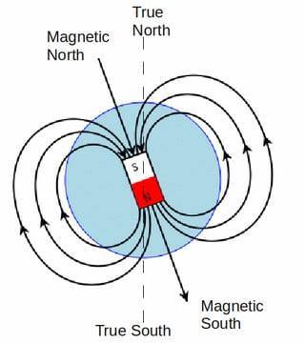
True North and magnetic north

Slide 10
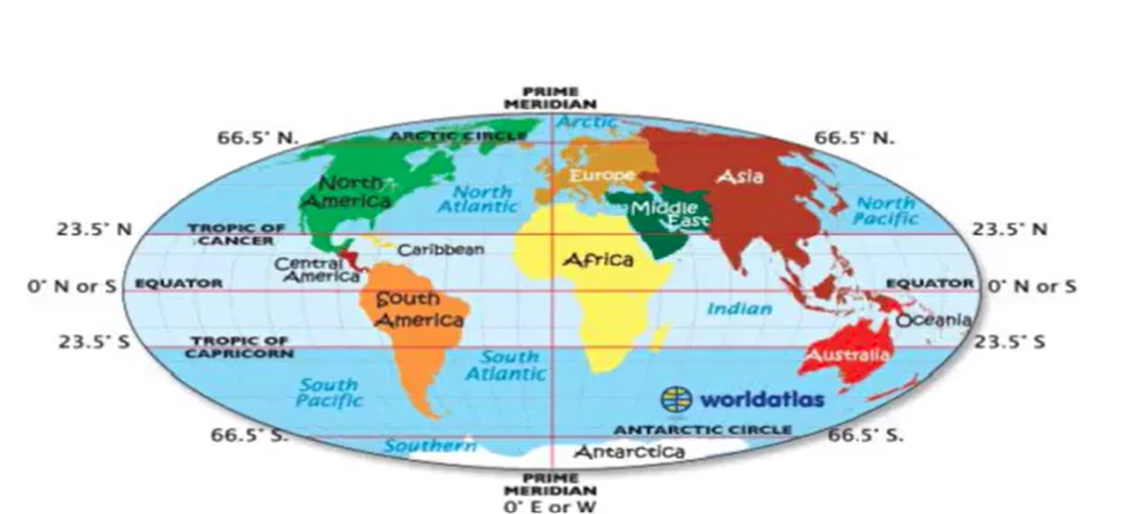
Geographical Co-Ordinates

Slide 11
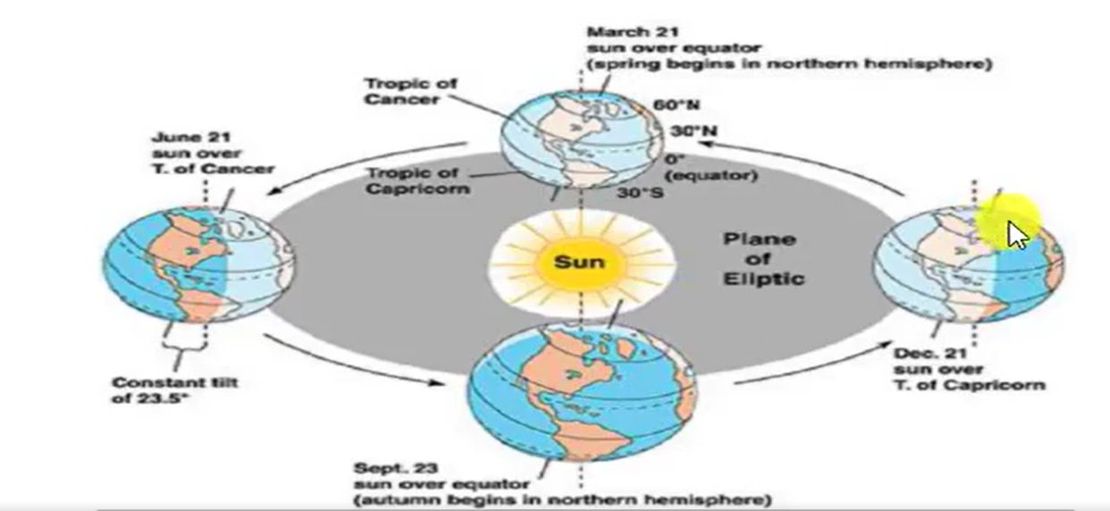
Variation of sun position

Slide 12
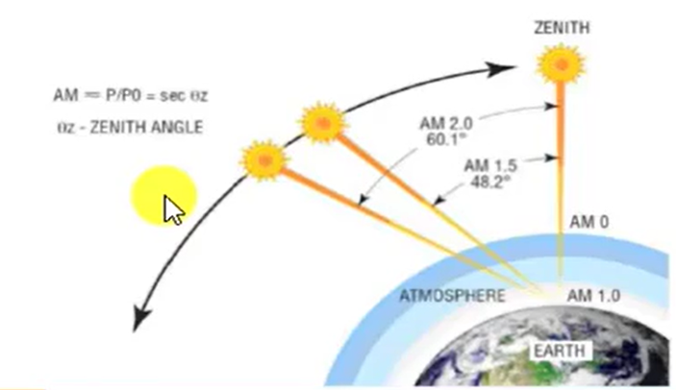
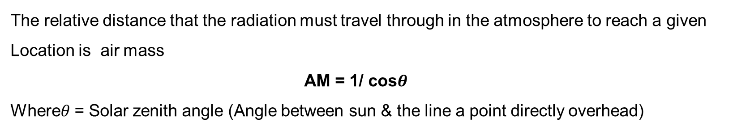
Air Mass
The relative distance that the radiation must travel through in the atmosphere to reach a given
Location is air mass
AM = 1/ cos$θ$
Where$θ$ = Solar zenith angle (Angle between sun & the line a point directly overhead)

Slide 13
Thank You

